Slide 1
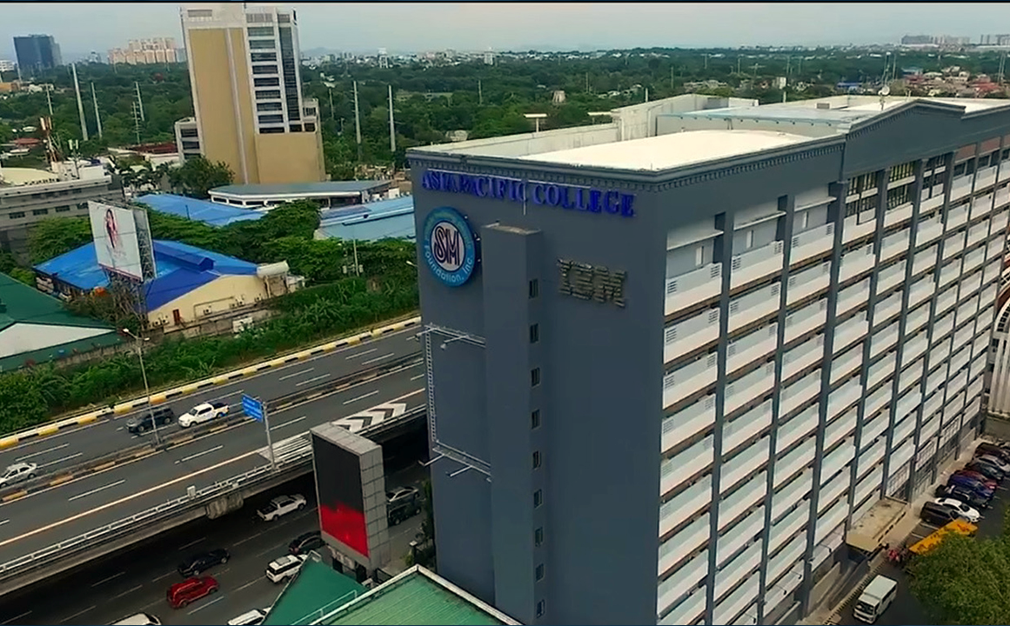
DHAN SYSTEM
TEAM DHAN

Slide 2


Slide 3

Ryan John Perez
OUR ADVISER

Slide 4

Project context

Slide 5
ABOUT THE PROJECT
In the contemporary medical industry, reliable supply chain management is critical for ensuring the timely availability of essential medical equipment (MRI, Electrolytes analyzer, hospital beds, non-consumables). The complexity of handling various medical equipment, the need for fast and efficient tagging, and the imperative to maintain accurate records necessitate a comprehensive supply chain management system. Recognizing these challenges, our team will develop the DHAN Supply Chain Management System (SCMS), a solution specifically designed for MEGAION, involved in storing, distributing, and delivering medical equipment.

Slide 6
Objectives

Slide 7
The project aims to:
To reduce the delay in checking stock levels for items that are for delivery or demonstration by 95%.
To optimize processes and ensure seamless coordination among stakeholders in the supply chain of MEGAION, particularly when sourcing hospital equipment from various suppliers.
To streamline the process for retrieving and logging demonstration machines to mitigate instances of missing stock.

Slide 8
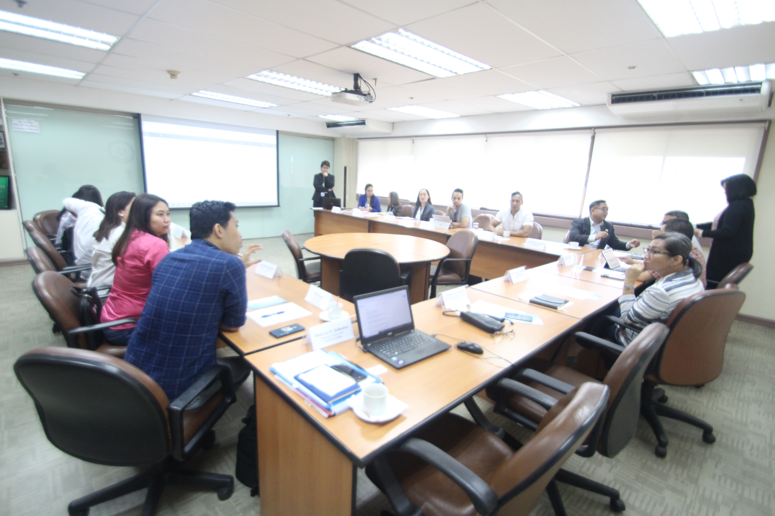
COMMENTS MATRIX

Slide 9
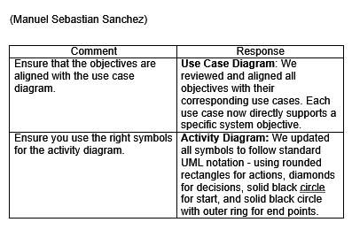
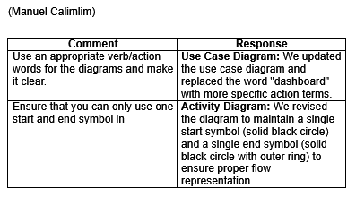
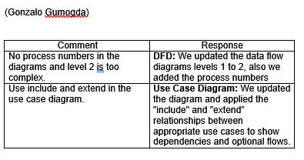
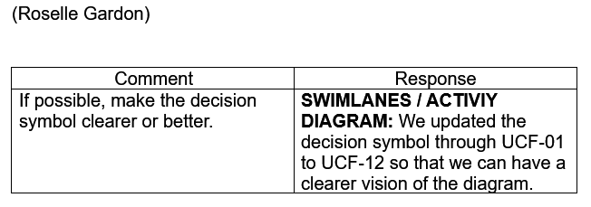

Slide 10
DATA FLOW DIAGRAMS (DFD)

Slide 11
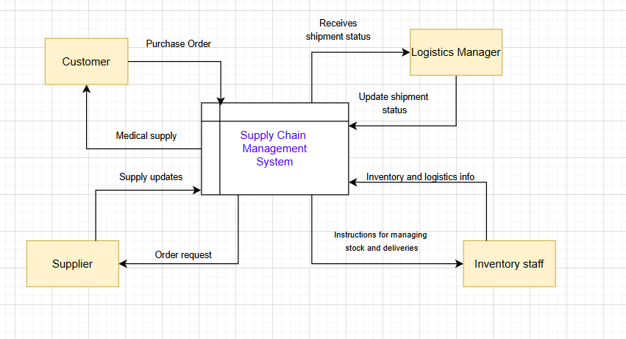
LEVEL 0 DFD

Slide 12
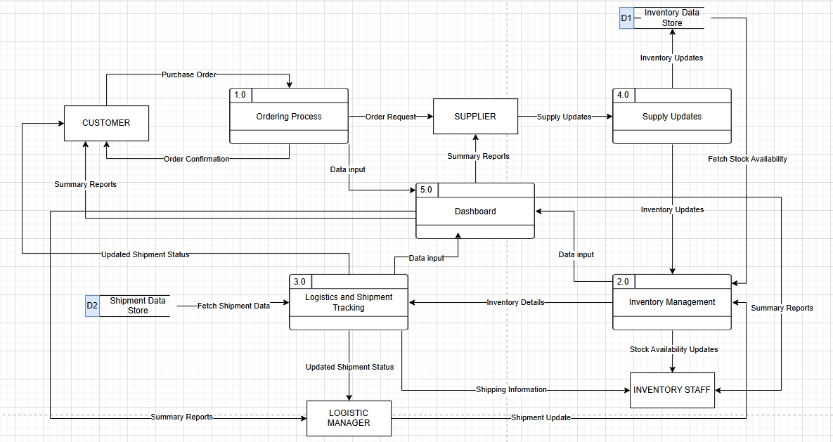
LEVEL 1 DFD (BEFORE)

Slide 13
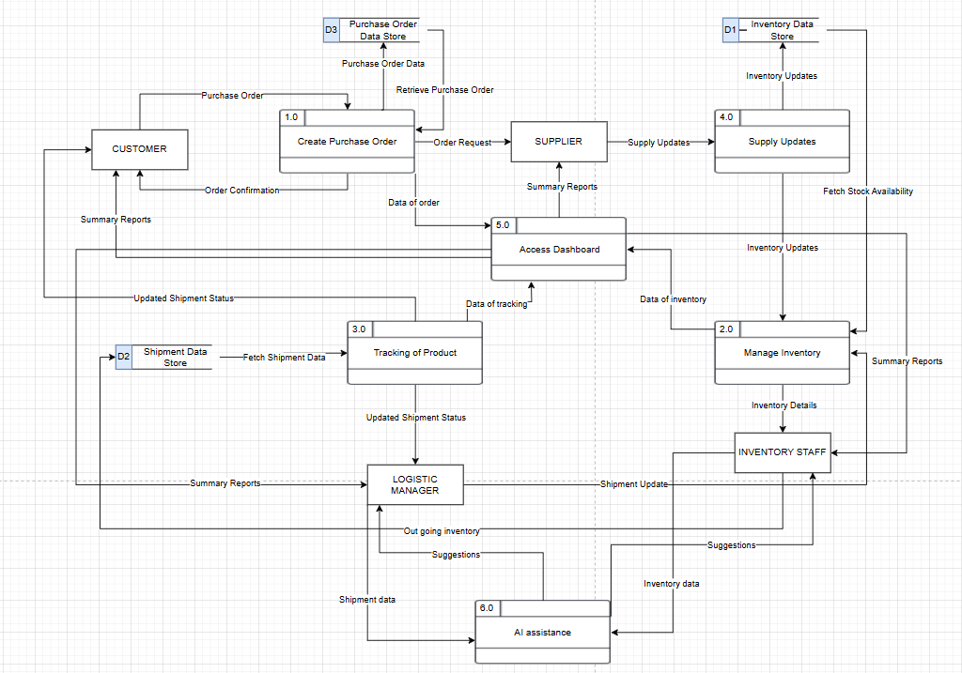
LEVEL 1 DFD (AFTER)

Slide 14
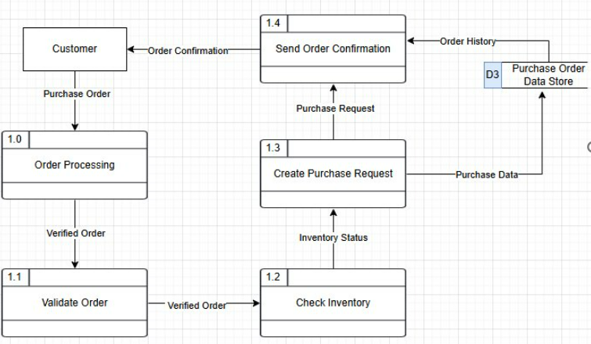
ABOUT THE PROJECT

Slide 15
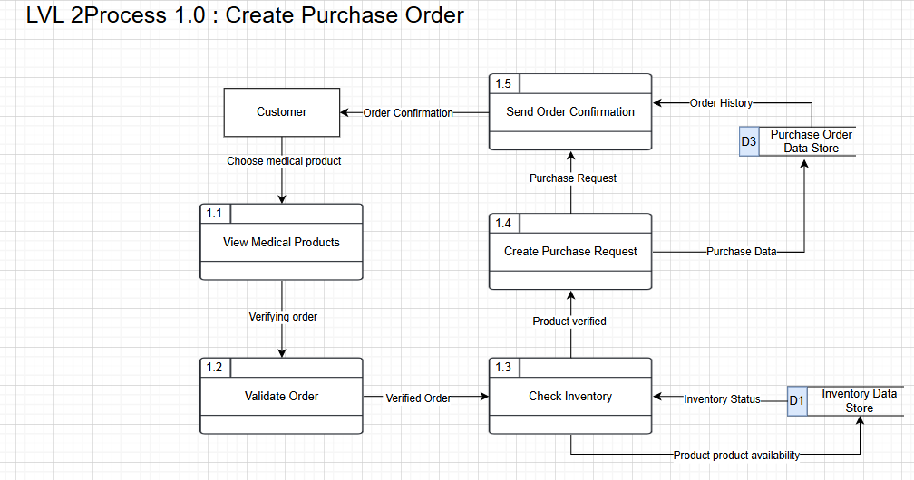
ABOUT THE PROJECT

Slide 16
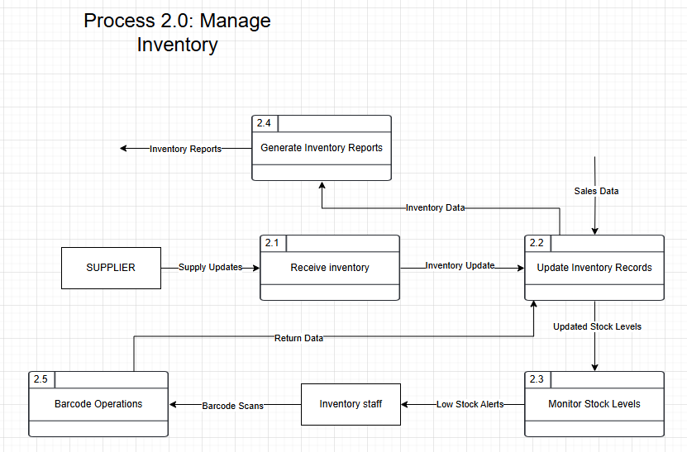
ABOUT THE PROJECT

Slide 17
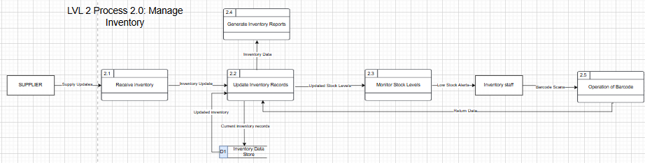

Slide 18
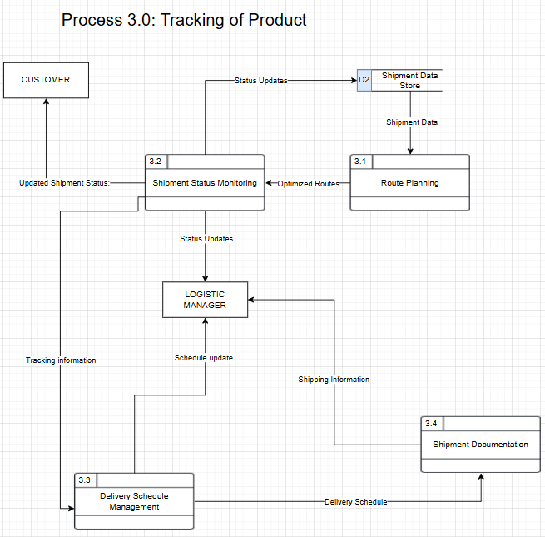

Slide 19
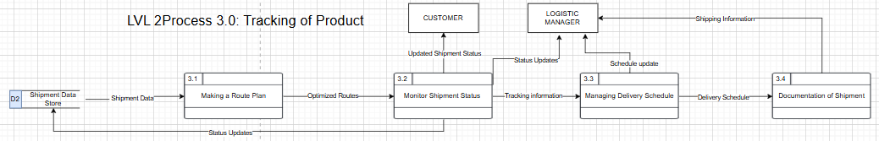

Slide 20
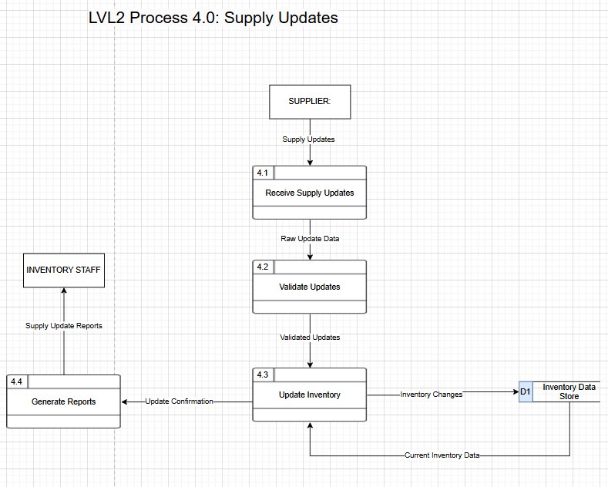

Slide 21
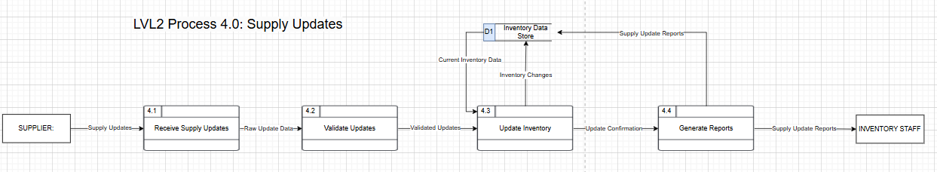

Slide 22
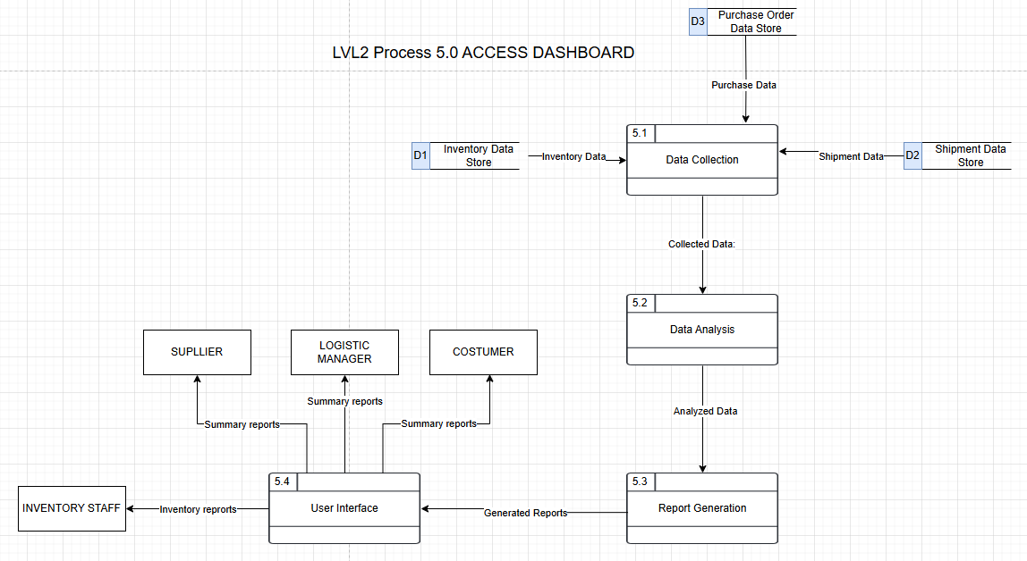

Slide 23
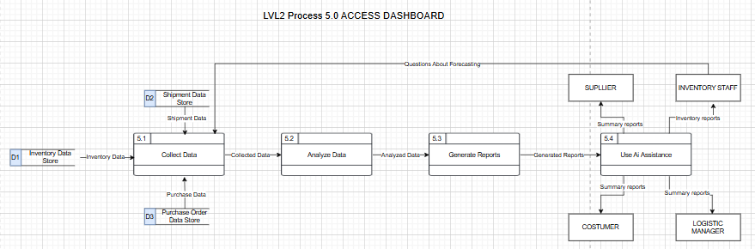

Slide 24
Use case diagram

Slide 25
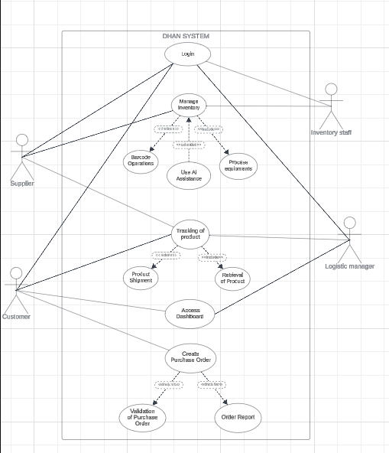
Use case diagram

Slide 26
Swimlane diagram

Slide 27
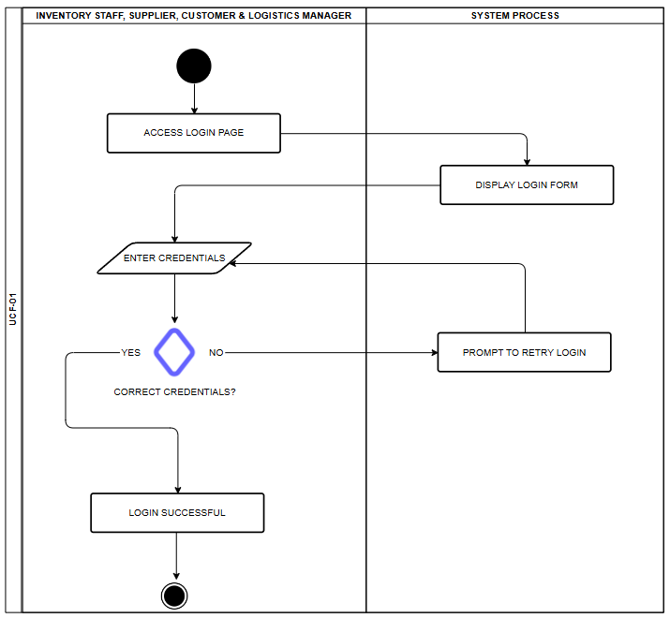

Slide 28
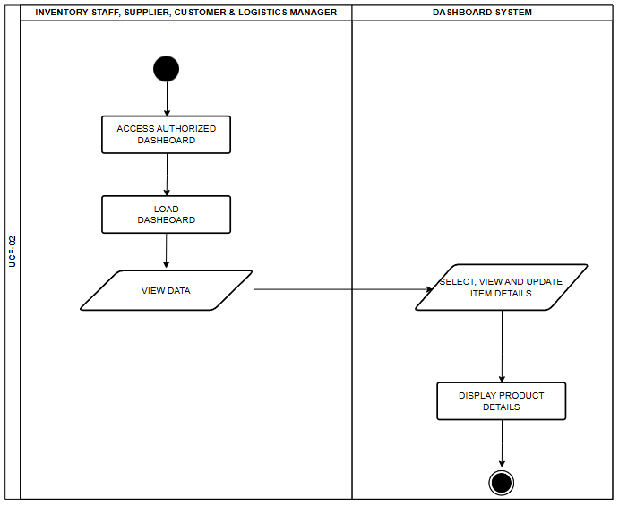

Slide 29
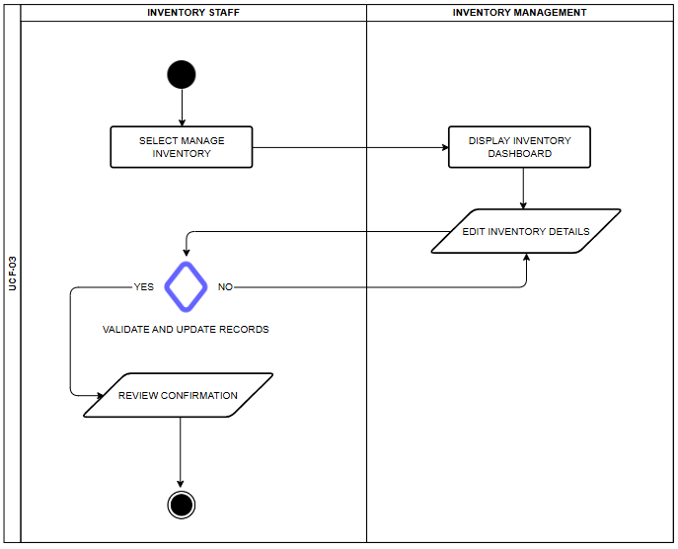

Slide 30
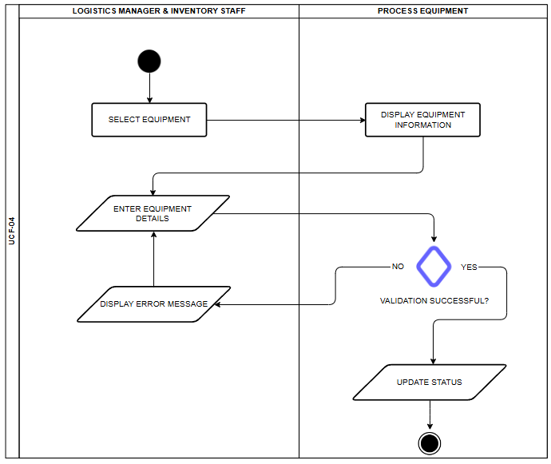

Slide 31
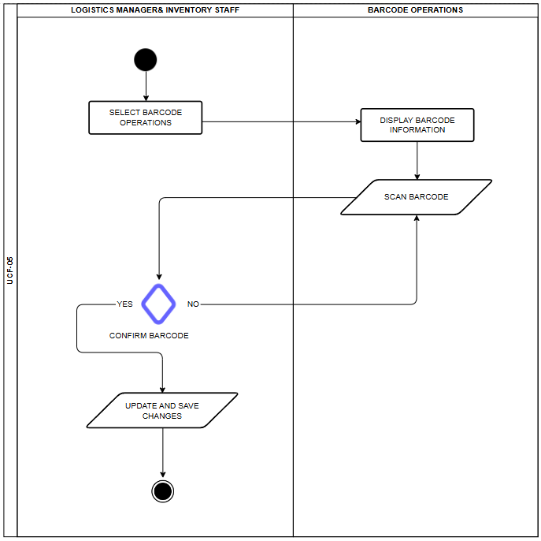

Slide 32
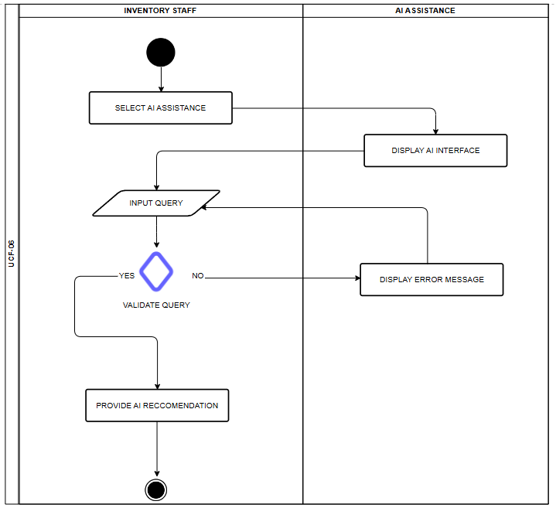

Slide 33
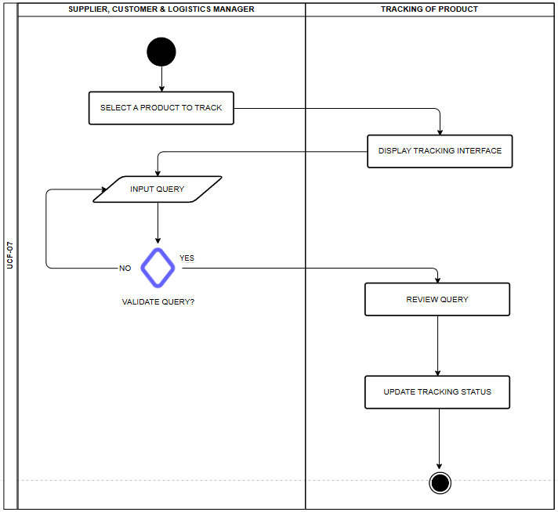

Slide 34
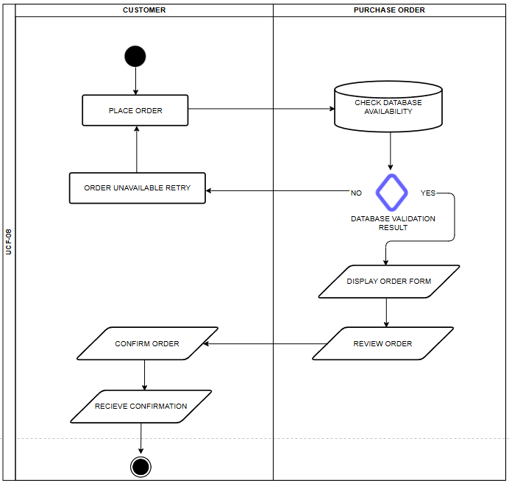

Slide 35
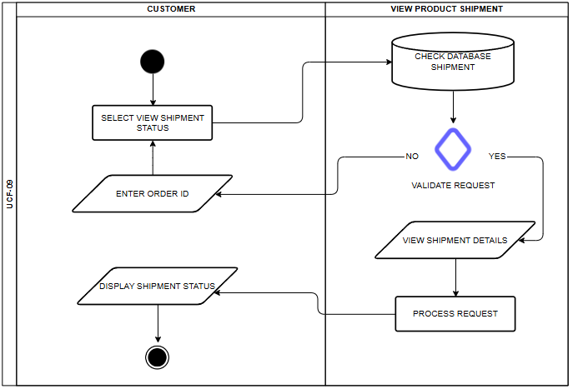

Slide 36
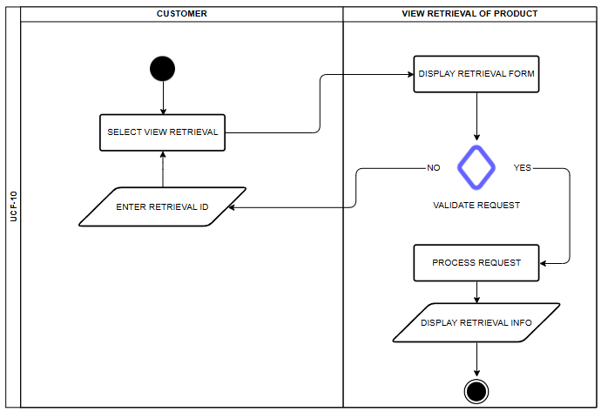

Slide 37
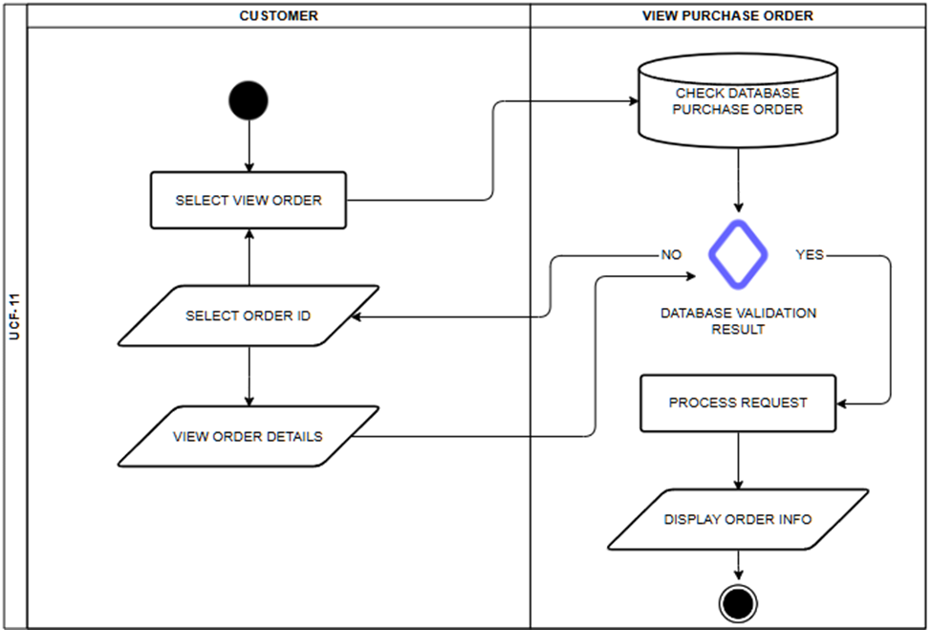

Slide 38


Slide 39
ERD

Slide 40
